Slide 1

WELCOME
to the
New York Chapter
of
CoreNet Global, Inc.
Your CoreNet
Compass Points Web Navigator
(Double Click to Open)

Slide 2
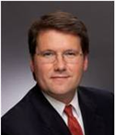

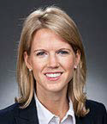
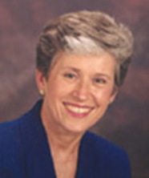
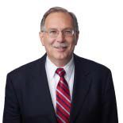
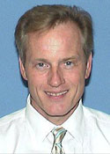
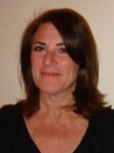
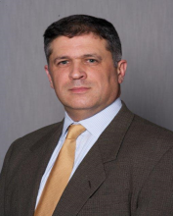
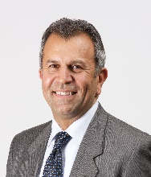
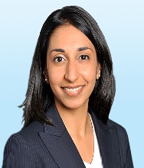


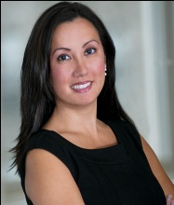

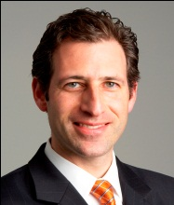
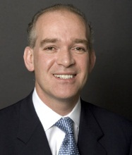



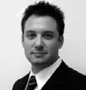
MEET NYC LEADERS
Executive Leadership
Lou D’Avanzo
Chairperson
Cushman & Wakefield
Dan Fishbein
President
CIT
Lauren Nanna
Vice President
General Atlantic
Lee Kosmac
Secretary
Newmark Grubb
Knight Frank
Dino Piccini
Treasurer
DTZ
Board of Directors & Advisors
Barry Alton Jody Brown Jonathan Coun Saeid Garebaglow Sheena Gohil Ted Moudis Cindy Quan Mindy Williams
Communities Programs Membership Specific Industry Group Workshops Sponsorship External Relations Special Events
Jefferies Thomson Reuters Interpublic Morgan Stanley Colliers Ted Moudis Goldman Sachs L&K Partners
Associates
Pay Wu Lou Nowikas Marcus Rayner Kathy Winkler Dale Schlather Paul Darrah Jason Aster
Advisor Advisor Advisor Advisor Advisor Advisor Counsel
American Express Hearst Prudential Cushman & BLT Office KBA Lease
Corporation Wakefield

Slide 3
NYC Membership Statistics
973 members as of April 1, 2015
Representing 148 unique end-user companies
50% of these end-users are employed by companies in the Fortune 500
Half of all Fortune 500 companies that are based in New York State employ a CoreNet member
Composition
NYC is the largest chapter in CoreNet Global

Slide 4


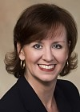
CoreNet Global
About
The world’s leading association for corporate real estate and workplace professionals, service providers, and economic developers
Headquartered in Atlanta
Membership
8,000 members worldwide across 45 local chapters
Memberships offered only to individuals, not corporations
CoreNet Global membership includes 70% of the Fortune 100 companies
Nearly half of the Forbes Global 2000 companies are represented in CoreNet Global
The members of which meet locally, globally, and virtually to develop networks, to share knowledge and resources, to learn, to thrive professionally, and to build friendships
Governance
Jim Scannell, Chairman
Randy Smith, Chairman Elect
Angela Cain, CEO
Jim Scannell Randy Smith Angela Cain
Chairman Chairman - Elect CEO

Slide 5
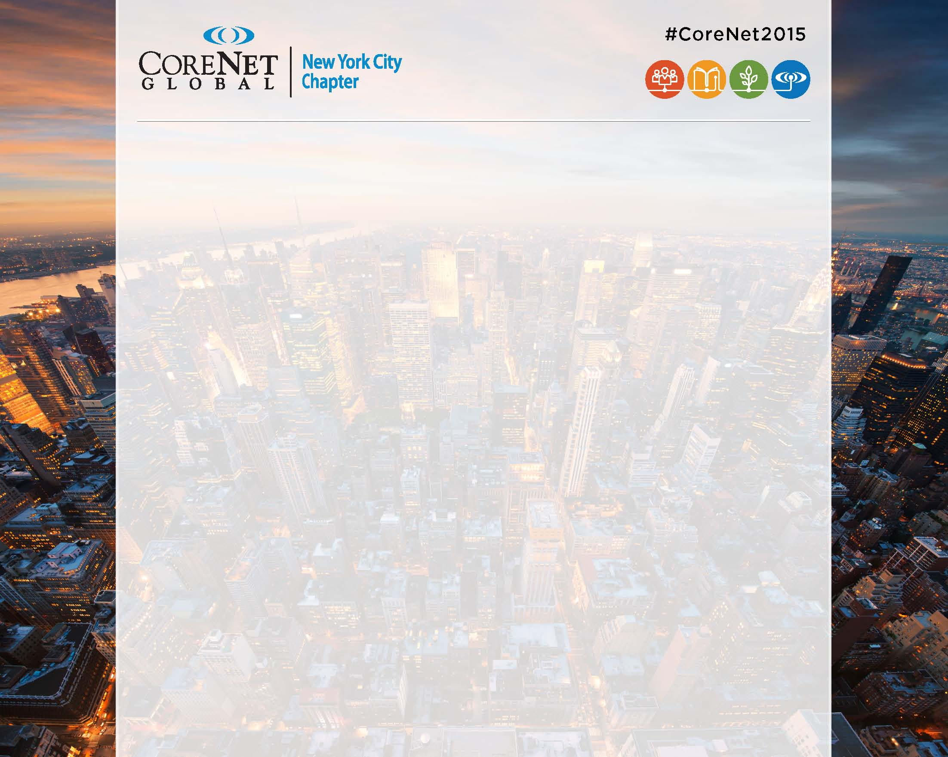
Member Benefits
Member Directory & Job Board
The Member Directory is a invaluable resource for making connections
Career Search – Job Listings
Education
CoreNet Global offers MCR and SLCR certifications
Publications and Articles
Events
CoreNet Global hosts worldwide summits and regional meet-ups every year. Check the CoreNet calendar for details
The New York City Chapter hosts over 40 events every year, including:
Workshops
Programs
Special events including the Holiday Party, Dinner Gala, Golf Outing
Regional events
Social Networking
Facilitate a greater number of connections with us on Facebook, Twitter, and LinkedIn
Members in Transition (MIT) support groups & discounts

Slide 6

ENGAGE & PARTICIPATE
Leadership
Communities- Sustainability, SPP, Technology, Women’s, Young Leaders
External Relations
University Relations
Membership
Special Events- New Year’s Party, Annual Dinner, or Golf Outing
Special Interest Groups- Law, Executive, Media, Finance
Sponsorship
Admin- Awards, PR, Data Analytics
Workshops

Slide 7




Key Contact Info
Sponsorship: Ted Moudis, AIA – Ted Moudis Associates TedMoudis@tedmoudis.com
Administrator: Samantha Tursi – The Berman Group including: event admission, membership, e-mail blasts, NYC info stursi@bermangrp.com
Membership NYC: Jonathan Coun– Interpublic jonathan.coun@interpublic.com
Membership Global: Eleanor Estacio – CoreNet Global eestacio@corenetglobal.org
Connect With Us Online
Facebook.com/CoreNetGlobalNYC
Twitter.com/CoreNetGlobalNY
http://instagram.com/corenetglobalny
LinkedIn Group: “New York Chapter of CoreNet Global”

Slide 8

Thank you to our 2015 Learning Sponsor

Slide 9










Thank you to our 2015 Platinum Sponsors

Slide 10
Thank you to our 2015 Sponsors
Gold
LBA Realty Allsteel, Inc. Plaza Construction
Structure Tone Avison Young Colliers International
VVA Project Managers Fisher Brothers Enterprise Florida
& Consultants
Silver
Certified Moving & Storage Co.
Creative Office Pavilion
WB Wood
AFD Contract Furniture Inc.
L&K Partners
Kimball Office
Milrose Consultants
DORMA USA
Knoll
Bentley Prince Street
Arenson Office Furnishings
EvensonBest
Business Interiors by Staples
Humanscale​
G3 Architecture
Tag Wall, LLC
Consolidated Carpet
The Meehan Group
James E. Fitzgerald, Inc.
Steelcase
J.T. Magen & Company
Total Relocation Services
STUDIOS Architecture
Bronze
Technical Innovation Empire Office BDO USA, LLP Waldner’s Business Environment

